Slide 1
Pro Bono Civil Rights Litigation in USDC/Colorado
Kevin Homiak, Esq.
Hon. Kristen L. Mix
Andrew D. Ringel, Esq.

Slide 2
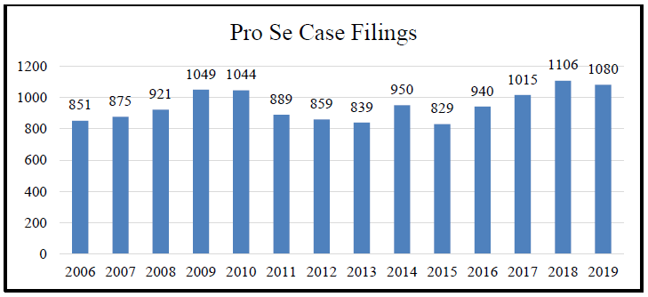
THE NEED

Slide 3
42 U.S.C. § 1983
Deprivation of a federal right
Under color of state law
Statute of limitations
No respondeat superior liability
Individual capacity vs. official capacity
Supervisory liability vs. municipal liability
Qualified immunity (more on this later)
Absolute immunity

Slide 4
Most frequent claims
Prisoner cases:
- Deliberate indifference to serious medical needs (8th and 14th amendments)
- Excessive force (8th or 14th amendment)
- Equal protection (14th amendment)
- Deliberate indifference to health and safety [conditions of confinement] (8th or 14th amendments)
- Due process [administrative segregation] (14th amendment)
- Retaliation (1st or 14th amendment)
- Religious issues (1st amendment)

Slide 5
Most frequent claims
Non-Prisoner cases:
Excessive force [police context](4th amendment)
Equal protection (14th amendment)
False arrest [police context] (4th amendment)
Due process [government employees] (14th amendment)
Free speech (1st amendment)

Slide 6
Monell Claims
Local government or private company liability based on:
Policy statements
Ordinances
Decisions by government rulemakers
“Custom or usage”
Policy or custom of inadequate training, supervision, discipline, screening or hiring
Conduct of policymaking officials

Slide 7
Prison Litigation reform Act (‘PLRA”)
Exhaustion of administrative remedies
No compensatory damages unless physical injury
This Photo by Unknown Author is licensed under CC BY

Slide 8
Qualified immunity
This Photo by Unknown Author is licensed under CC BY-SA

Slide 9
What you need to Know
► Client communications
► Drafting an (amended) complaint
► Defending a MTD
► Extending deadlines
► Re-opening discovery
► Discovery strategies
► MSJs
► Reimbursements
► Attorneys’ fees and costs
This Photo by Unknown Author is licensed under CC BY

Slide 10
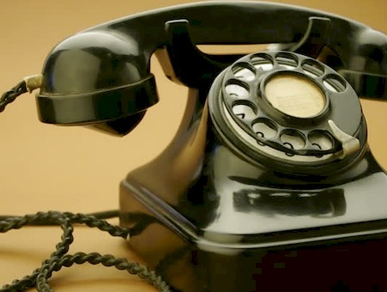
Logistics in prisoner litigation
Contact and communication
Engagement letters
Managing expectations
Settlement
This Photo by Unknown Author is licensed under CC BY

Slide 11
The Pro Bono Panel
Faculty of Federal Advocates

Slide 12
Questions?

